Slide 1
Object Oriented Programming (CSC-205) Lecture: 03 Getting Familiar with Object-Oriented Environment (Inheritance)

Slide 2
Agenda for Today
To learn and understand the concept of Inheritance
To create new classes by inheriting from existing classes
To understand how inheritance promotes software reusability
To understand the notions of base classes and derived classes

Slide 3
Inheritance
(Hierarchy)
New classes created from existing classes
Absorb attributes and behaviors
Expresses commonality among objects
Allows code reusability
Highlights Generalization / Specialization relationships

Slide 4
Polymorphism
(Multiformity)
The ability of objects to respond differently to the same message or function call
Write programs in a general fashion
Handle a wide variety of existing (and unspecified) related classes

Slide 5
Object-Orientation Evolution
Modules
Information hiding
Data encapsulation
Abstract data types
Objects

Slide 6
Base Class
A class from which other classes are derived
It facilitates the creation of other classes that can reuse the code implicitly inherited from the base class (except constructors and destructors)
A programmer can extend base class functionality by adding or overriding members relevant to the derived class (Polymorphism)
Also known as Parent Class or Super Class

Slide 7
Derived Class
A class that is created from the base class (a previously existing class)
Inherits all of the member variables and methods of the base class from which it is derived i.e. it inherits both data and behavior
Also known as child class or sub class

Slide 8
Base Class VS Derived Class
(Properties)
Base classes are automatically instantiated before derived classes
The derived class can communicate to the base class during instantiation by calling the base class constructor with a matching parameter list
Base class members can be accessed from the derived class through an explicit cast
A derived class can be used anywhere the base class is expected
However, a base class CANNOT be used anywhere the derived class is expected

Slide 9
Inheritance
(Hierarchy)
Base Class (Employee)
Data₁+Procedures₁
Child Class LEVEL 1 (Teacher)
Child Class LEVEL 1 (Admin)
Data₂ + Procedures₂
Data₃ + Procedures₃
Child Class LEVEL 2(AdminTeacher)
Data₄ + Procedures₄

Slide 10
How do we do that?
(The colon “:” operator)
class Derived: BaseClass
class Cat : public Animal
class Faculty : public Employee
class Rectangle : private Area, private Perimeter

Slide 11
How do we access the parent elements?
(The dot“.” operator)
x.Foo()
Employee.Printpay()
Rectangle.setval(4,5)
r.get_data()
Hence its same as in normal class

Slide 12
Quick Example
#include <iostream>
using namespace std;
// Base class
class Shape
{
public:
void setWidth(int w)
{
width = w;
}
void setHeight(int h)
{
height = h;
}
protected: int width; int height;
};
// Derived class
class Rectangle: public Shape
{
public:
int getArea()
{
return (width * height);
} };
int main(void)
{
Rectangle Rect;
Rect.setWidth(5);
Rect.setHeight(7); // Print the area of the object.
cout << "Total area: " << Rect.getArea() << endl;
return 0; }

Slide 13
Quick Example
#include <iostream>
using namespace std;
// Base class
class Shape
{
public:
void setWidth(int w)
{
width = w;
}
void setHeight(int h)
{
height = h;
}
protected: int width; int height;
};
// Derived class
class Rectangle: public Shape
{
public:
int getArea()
{
return (width * height);
} };
int main(void)
{
Rectangle Rect;
Rect.setWidth(5);
Rect.setHeight(7); // Print the area of the object.
cout << "Total area: " << Rect.getArea() << endl;
return 0; }
Defining base class here

Slide 14
Defining the base class
// Base class
class Shape
{
public:
void setWidth(int w)
{
width = w;
}
void setHeight(int h)
{
height = h;
}
protected: int width; int height;
};
Members of base class

Slide 15
Quick Example
#include <iostream>
using namespace std;
// Base class
class Shape
{
public:
void setWidth(int w)
{
width = w;
}
void setHeight(int h)
{
height = h;
}
protected: int width; int height;
};
// Derived class
class Rectangle: public Shape
{
public:
int getArea()
{
return (width * height);
} };
int main(void)
{
Rectangle Rect;
Rect.setWidth(5);
Rect.setHeight(7); // Print the area of the object.
cout << "Total area: " << Rect.getArea() << endl;
return 0; }
Defining base class here
Defining child class here

Slide 16
Defining the child class
// Derived class
class Rectangle: public Shape
{
public:
int getArea()
{
return (width * height);
}
};
Member of child class

Slide 17
Quick Example
#include <iostream>
using namespace std;
// Base class
class Shape
{
public:
void setWidth(int w)
{
width = w;
}
void setHeight(int h)
{
height = h;
}
protected: int width; int height;
};
// Derived class
class Rectangle: public Shape
{
public:
int getArea()
{
return (width * height);
} };
int main(void)
{
Rectangle Rect;
Rect.setWidth(5);
Rect.setHeight(7); // Print the area of the object.
cout << "Total area: " << Rect.getArea() << endl;
return 0; }
Defining base class here
Defining base class here
child class accessing base class members

Slide 18
Accessing the base class members
child class accessing base class members
int main(void)
{
Rectangle Rect;
Rect.setWidth(5);
Rect.setHeight(7); // Print the area of the object.
cout << "Total area: " << Rect.getArea() << endl;
return 0; }
child class accessing its own member

Slide 19
Access Control and Inheritance
public: The members declared as Public are accessible from outside the Class through an object of the class
protected: The members declared as Protected are accessible from outside the class BUT only in a class derived from it
private: These members are only accessible from within the class. No outside Access is allowed
Derived class member functions – Cannot directly access private members of their base class
Maintains encapsulation – Hiding private members is a huge help in testing, debugging and correctly modifying systems

Slide 20
Access Control Syntax
public : member-declarations
private : member-declarations
protected : member-declarations
The members declared after the specifier have public/protected/private member access

Slide 21
Quick Example
class MyClass {
public: int a;
protected: int b;
private: int c;
};
int main()
{
MyClass obj;
obj.a = 10;
obj.b = 20;
obj.c = 30;
}

Slide 22
Quick Example
class MyClass {
public: int a;
protected: int b;
private: int c;
};
int main()
{
MyClass obj;
obj.a = 10; //Allowed
obj.b = 20; //Not Allowed, gives compiler error
obj.c = 30; //Not Allowed, gives compiler error
}

Slide 23
Example Program
#include <iostream>
using namespace std;
class Person {
int id;
char name[100];
public:
void set_p()
{
cout << "Enter the Id:";
cin >> id;
cout << "Enter the Name:";
cin >> name;
}
void display_p()
{
cout << endl <<"Id: "<< id << "\nName: " << name <<endl;
}
};
class Student : private Person {
char course[50];
int fee;
public:
void set_s()
{
set_p();
cout << "Enter the Course Name:";
cin >> course;
cout << "Enter the Course Fee:";
cin >> fee;
}
void display_s()
{
display_p();
cout <<"Course: "<< course << "\nFee: " << fee << endl;
}
};
int main()
{
Student s;
s.set_s();
s.display_s();
return 0;
}

Slide 24
Types of Inheritance
Single Inheritance
Class inherits from one base class
Multiple Inheritance
Class inherits from multiple base classes
Multi-Level Inheritance
Class inherits from another child class

Slide 25
Multilevel Inheritance
A class can also be derived from one class, which is already derived from another class.
In the following example, MyGrandChild is derived from class MyChild (which is derived from MyClass).
// Base class (parent) class MyClass { public: void myFunction() { cout << "Some content in parent class." ; } }; // Derived class (child) class MyChild: public MyClass { }; // Derived class (grandchild) class MyGrandChild: public MyChild { }; int main() { MyGrandChild myObj; myObj.myFunction(); return 0; }

Slide 26
Multiple Inheritance
A class can also be derived from more than one base class, using a comma-separated list:
// Base class class MyClass { public: void myFunction() { cout << "Some content in parent class." ; } };
// Another base class class MyOtherClass { public: void myOtherFunction() { cout << "Some content in another class." ; } };
// Another base class class MyOtherClass { public: void myOtherFunction() { cout << "Some content in another class." ; } }; // Derived class class MyChildClass: public MyClass, public MyOtherClass { }; int main() { MyChildClass myObj; myObj.myFunction(); myObj.myOtherFunction(); return 0; }

Slide 27
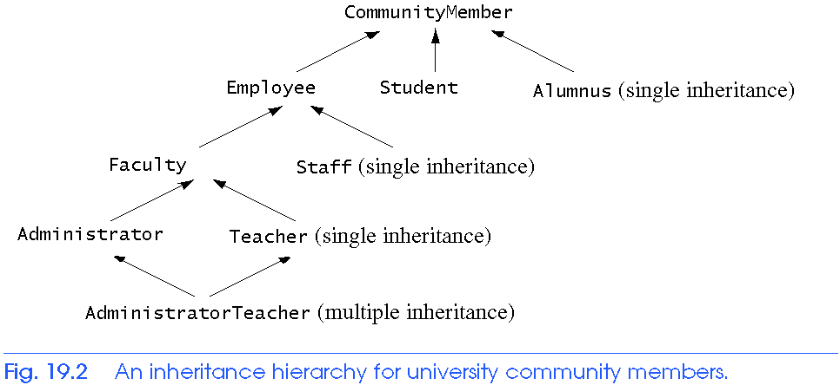
Inheritance
(Multiple and Multilevel)
Multi-Level Inheritance

Slide 28
Quick Example
(Multiple Inheritance)
#include<iostream>
using namespace std;
class Person { // Data members of person
public:
Person(int x) { cout << "Person::Person(int ) called" << endl; }
};
class Faculty : public Person { // data members of Faculty
public:
Faculty(int x):Person(x) {
cout<<"Faculty::Faculty(int ) called"<< endl; }
};
class Student : public Person { // data members of Student
public:
Student(int x):Person(x) {
cout<<"Student::Student(int ) called"<< endl; }
};
class TA : public Faculty, public Student { //Multiple Inheritance
public:
TA(int x):Student(x), Faculty(x) {
cout<<"TA::TA(int ) called"<< endl;}
};
int main() {
TA ta1(30);}

Slide 29
Multiple Inheritance
task
1. Declare the base class student
Declare and define the function get() to get the student details:
Roll_num and Marks (2 marks (m1, m2) to be entered)
2. Declare the other class sports
Declare and define the function getsm() to read the sports mark
Sport_marks (to be entered)
3. Create the class statement derived from student and sports
Declare and define the function display()
to find out the total and average
4. Declare the derived class “statement” object
call the functions get(),getsm() and display()

Slide 30
What about these?
class_name : protected base_classes
class_name : public base_classes
class_name : private base_classes

Slide 31
To be cont…

